Slide 1

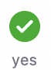
Turn video on,
enable mic & say:
“Hi, this is _(name)_,
I ate ___________ for breakfast”
Click when done
Participants
Chat

Slide 2
Logistics
Walk through
A0
Paper Reviews
Project list is up (still evolving)
Course goal
You feel comfortable reading papers + conducting research
Research ~ answering your own questions

Slide 3

Today’s session
Finish previous class
Review classic DBMS components
Notes on w6113.github.io

Slide 4
#ScholarStrike
Notes:
Supposed to be a two day strike where you don’t do any professor related tasks and learn about BLM and challenges of underrepresented people, and what can be done to help

Slide 5
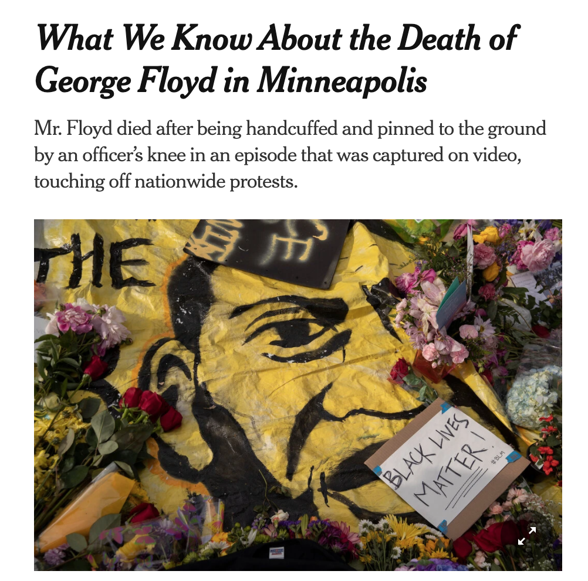
Black Lives Matter
Notes:
Discuss where all of this started and popularized this year, which, for me was the black lives matter protests.
BLM has been around for many years, but the very public, and unfair, murders of black people by police ignited the movement
For instance, geore floyd

Slide 6

Black Lives Matter
Notes:
Breonna Taylor was a nurse just at home in her apartment

Slide 7
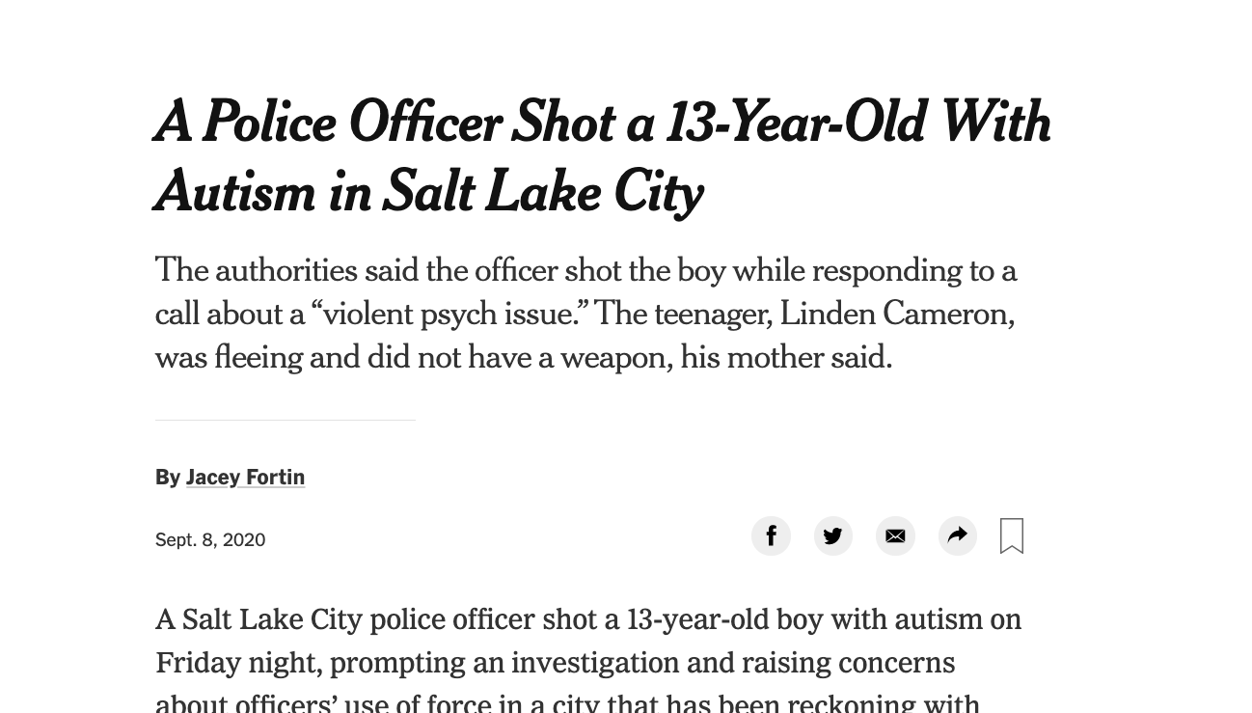
Black Lives Matter
Notes:
Linden Cameron was a 13 year old shot in the back

Slide 8
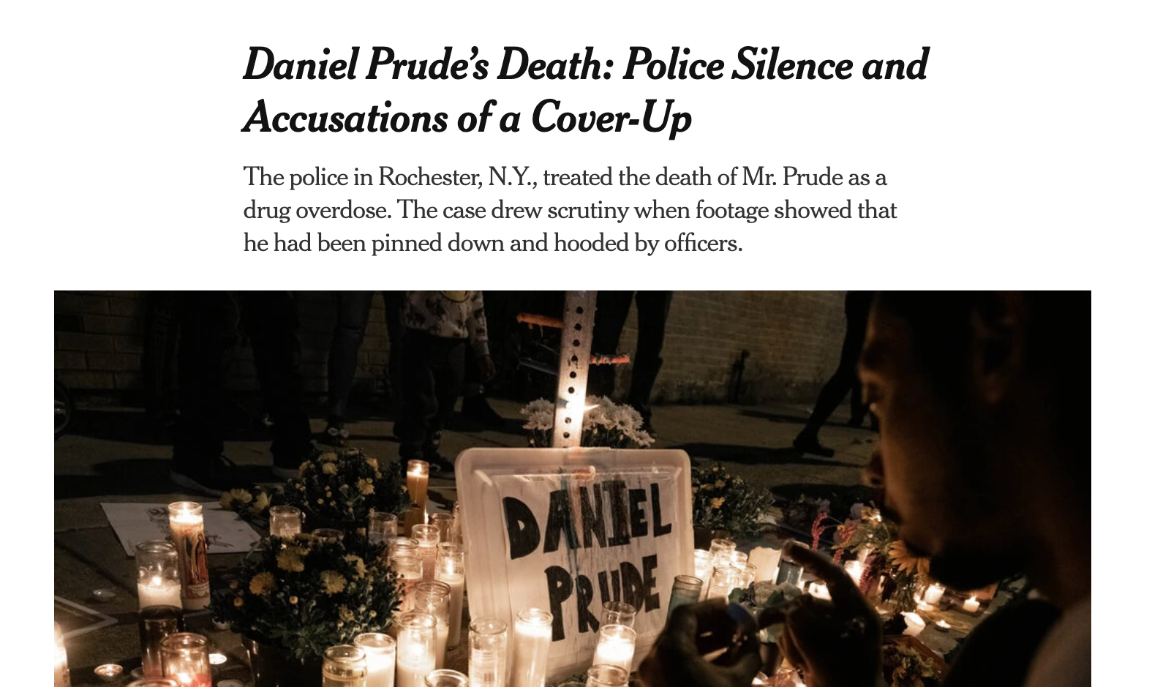
Black Lives Matter
Notes:
And Daniel Prude who was pinned and hooded by officers, who then blamed it on drug overdose, which leverages deep seated biases about black people.
These events are tragic, and simply symptoms of a deep disparity between African americans and the rest of America.
The US has historically treated immigrants of all kinds poorly, but African americans have been systematically oppressed from day one of the nation’s founding.
BLM is simply the manifestation of the outrage at this inequity

Slide 9

Notes:
Recently the WNBA led the sports world in going on a strike to further publicize this issue, and other sports leaguse followed.
ScholarStrike was a reaction by academics in support of this

Slide 10
Search terms to learn more
john oliver police
Netflix 13th
The case for reparations
shutdownstem
Notes:
Rather than cancel class, I’ll list here terms that are worth searching for to educate your self a bit about what’s going on. We will share these terms in the slack.
These are issues that I am not an expert in either, but I am happy to discuss these in recitation or OH.

Slide 11
Your Tasks for next class
Submit reviews for Tuesday
Submit Assignment 0 by 9/13 11:59PM EST
w6113.github.io

